Slide 1
For Africa by Africa Harnessing the power of African giving and African-led institutions in championing Africa’s development agenda
7 April 2021
Faustina Fynn-Nyame
CIFF Executive Director, Africa

Slide 2
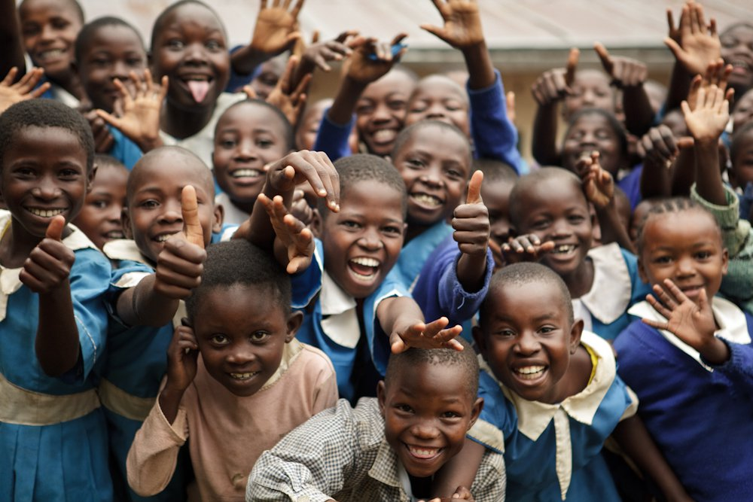
THE CHILDREN’S INVESTMENT FUND FOUNDATION
Overview
CIFF is an independent philanthropic organisation with offices in Addis Ababa, Beijing, London, Nairobi and New Delhi
CIFF has been working in Africa for over 15 years. The Nairobi office has been operational since 2009, and in 2019 we opened our office in Addis Ababa, Ethiopia
Established in 2002, we have no religious or political affiliation.
We work with a range of partners seeking to transform the lives of children and adolescents. Partnerships are critical because it will take the combined efforts of many to urgently tackle the challenges faced by children and their families
Notes:
Established in 2002, we have no religious or political affiliation.

Slide 3
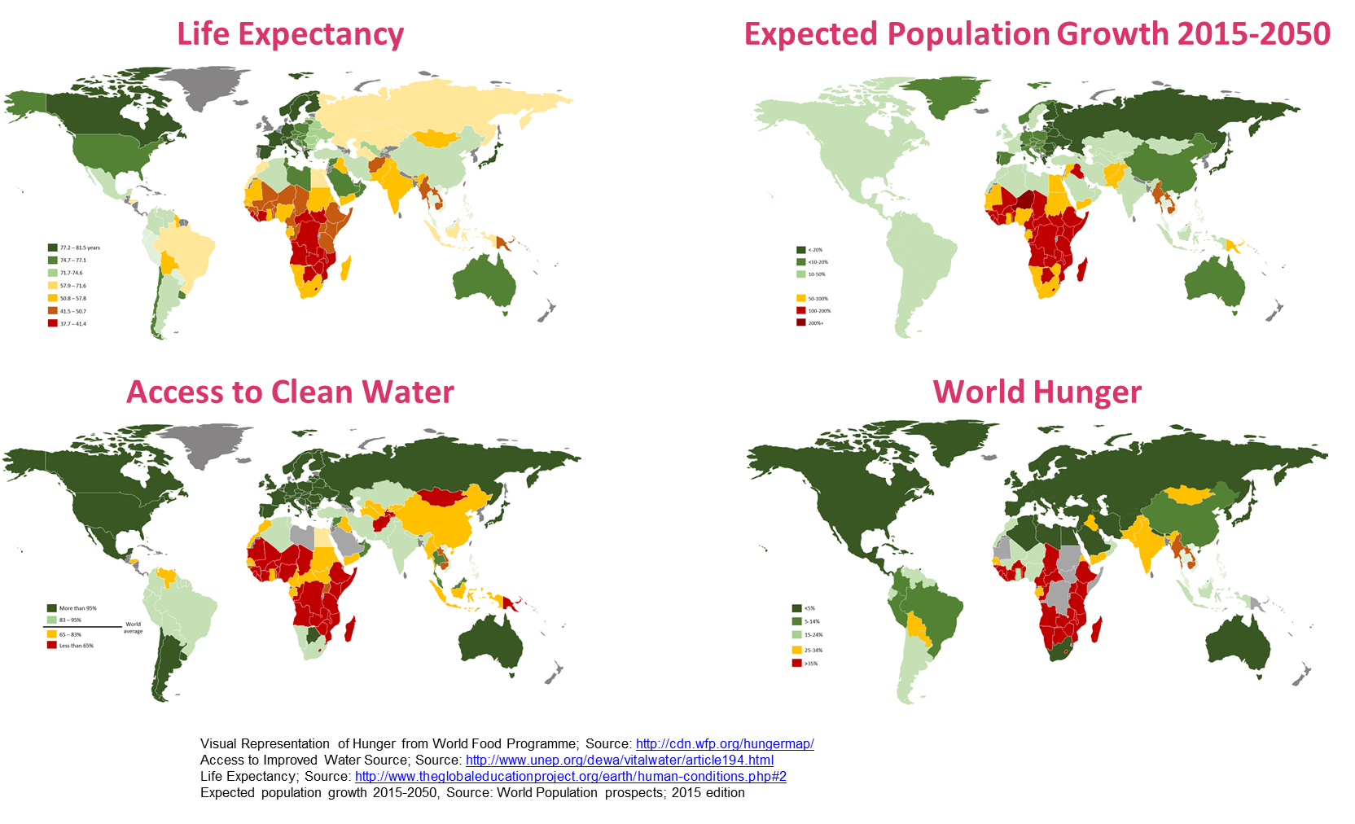
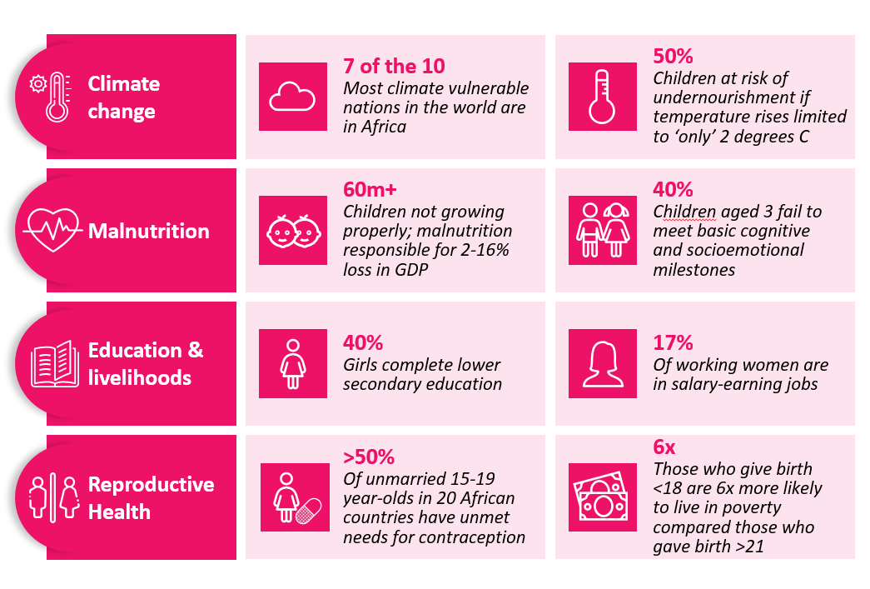
Context: Africa is doing poorly against a multitude of global indicators. We will need new and transformative approaches to change our trajectory

Slide 4
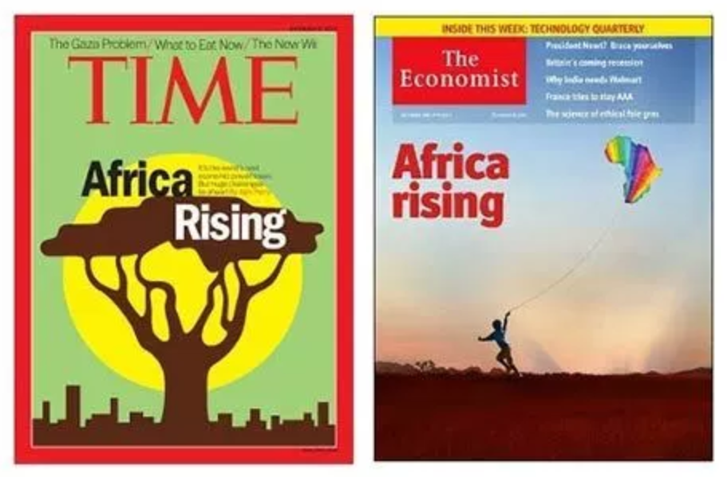
We are a continent primed to realise significant potential
OPPORTUNITIES
Central opportunity: human capital + demographic transition
Accelerating a decline in fertility and child mortality are preconditions for investments in increasing human capital to deliver a ‘demographic dividend’
A demographic dividend requires supportive policies that lower dependency ratios, ensure a healthy transition to adulthood and increase youth employment - especially for girls
Countries that have high fertility need a greater focus on demographic transition (e.g., contraception, delaying age of marriage), whilst those with lower fertility have the opportunity to grow human capital - through skills, employment and female labour force participation
Cross-cutting opportunities
Digitisation
Huge increases in smartphone ownership (33%) and regular internet (41%) create opportunities for civic engagement, data capture, and accountability to target populations
Political evolution
Increased popular political activism and engagement. Africans are aware of and demanding for their rights
Financial Times: “Improved governance means the continent is almost predestined to enjoy a long period of mid-to-high single-digit economic growth, rising incomes and an emerging middle class."
African philanthropy
There are opportunities to fill a sustainability and funding vacuum with new African institutions and giving programs, funded by African sources or led by African voices

Slide 5
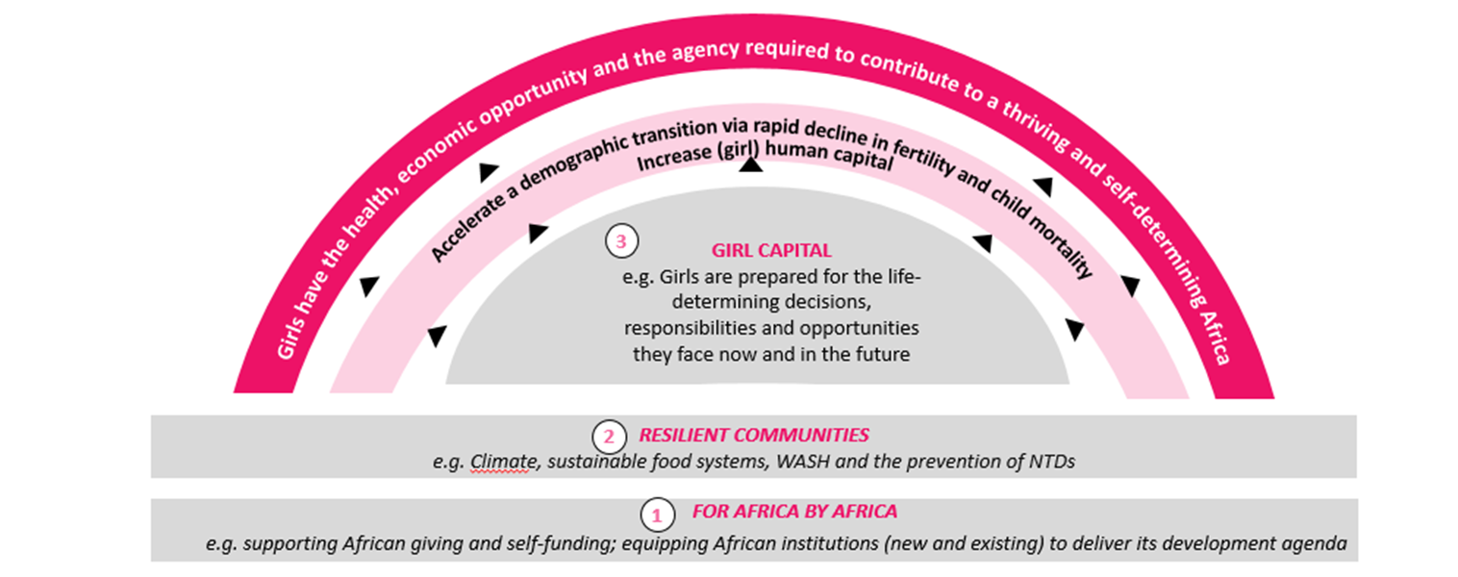
CIFF AFRICA – Strategy
Success Drivers
Integration
Africa’s challenges and opportunities are interwoven. Cross-sectoral, integrated approaches enabled for lasting social change.
Localisation
Local knowledge and insights, delivery of context-specific investments; government and other stakeholder partnerships
Execution
Use evidence to map out priority geographies. Improve execution of current portfolios and identify non-performance early, putting in place robust course correction actions
Sustainability
From the outset, all investments designed with sustainability in mind, with fit for purpose pathways defined and supported through complementary strategic engagement efforts
Notes:
The CIFF Africa strategy is hinged on integrated investment areas that lie at the heart of complex chains currently impeding Africa’s progress

Slide 6
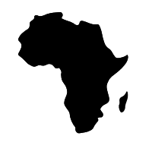
Priority investment area: ‘For Africa By Africa’ - harnessing the power of African giving and African-led institutions in championing the African development agenda
60%
16%
$56b
“If donors want to be more effective in Africa, they should be creating solutions with Africans, to the challenges diagnosed by Africans, using expertise and resources that are African. This is what real accountability and real sustainability actually mean.”
- Mairo Mandara
% of African population under 25 years of age (748M) and is expected to increase by 50% over the next 30 years
Of philanthropic funding for Africa goes to organisations headquartered in Africa
Estimated size of African giving (inc. $46b remittances)
Ensure sustainability by providing a transparent platform for diaspora ownership and co-investment in Africa’s development
MISSION
Work in partnership with African institutions to influence political economy around CIFF priorities, to maximize impact and sustainability of investments (AU, ECOWAS, COMESA)
Leverage existing African resources and work with African governments and institutions, to ensure Africa’s ownership of its own development agenda to foster sustainable change
Build the capacity of Civil Society to continue to hold governments accountable and sustain the momentum around CIFF priority areas
Nurture government relationships in focus countries to secure co-funding for and alignment on strategic priorities

Slide 7
Indigenous Social Investment in Africa- Key Facts & Figures
2013
164,000
Growth of no. of African US$ millionaires
2018
7.9%
177,000
Corporate Social Investment
Family Foundation
Diaspora
2023
13%
200,000
African Philanthropy is on the rise
Diaspora giving, corporate social investment and family foundations are the fastest growing segments of philanthropy/giving
The Foundation sector is growing fastest in China, Africa and India

Slide 8
Where do African Philanthropists Put Their Money?
Gender
Youth
Health
Education
Economic Empowerment
Health infrastructure, e.g. hospitals, clinics
Malnutrition & Stunting
HIV/AIDS
Primary healthcare
Emergency health relief – Ebola, COVID-19
Maternal & baby health
Scholarships for high school & tertiary education
Building of secondary schools
Construction & equipping of libraries
Scholarships to TVETs and other tertiary institutions
On-the-job education through internship, attachment and fellowship programmes
Coaching and Mentoring
Multi-sector: agribusiness, manufacturing, health, financial services, energy – focus is on improved incomes and livelihoods
Entrepreneurship programs focused on empowering and equipping entrepreneurs with well-rounded skills including access to finance, mentoring, coaching, life-skills training
Training: Employability & digital skills training
Supplier development programmes to support increased access for marginalised groups
Access to finance for micro, small and medium enterprises including start ups

Slide 9
African Philanthropists Need to Pay More Attention to…
Climate
Change
Food Security
Youth and more Youth
Human Rights
A focus on other SDGs that have potential to create job and self-employment opportunities for youth

Slide 10
Priority investment area: Resilient Communities - ensuring sustainable food systems that address climate, health, and nutritional needs. Furthering community norms that prevent adverse diseases.
7/10
90%
50%
“Africa is acutely vulnerable to climate change. It needs urgent climate adaptation to progress over the next 50 years. Without this, current climate vulnerability will cause extreme crises in food security, nutrition, and child development. Human safety and sustainable livelihoods will become impossible.”
- Prof. Alan Dangour, LSHTM
Of the most climate change-vulnerable countries are in Africa
Of African countries projected to see a 10-50% drop in cereal yields over coming years
Ethiopia has the highest prevalence of active Trachoma (the leading cause of blindness worldwide) ranging from 5 to 50%.
MISSION
Adapting diets and livelihoods to climate change
Tackling current crises such as micronutrient and protein deficiencies
Ensure the basis
for future thriving is assured by focusing on investments which push for strengthening community resilience to withstand climate change impacts as well as reduce the threat of disease
Dietary transitions towards nutritious foods and away from processed, as econ grows
Doubling down on the nexus between WASH and NTDs

Slide 11
Priority investment area: Girl Capital - preparing girls for the life-determining decisions and responsibilities they face now and in the future
“Everyone wins when children — and especially girls – have access to education. An educated girl is likely to increase her personal earning potential and prepare herself for a productive and fulfilling life, as well as reduce poverty in the whole community. Investing in girls’ education also helps delay early marriage and parenthood.”
- Angelique Kidjo
40%
17%
64%
Of girls complete secondary school
Of young women are in reliably paid employment
Projected reduction in child marriages if all girls in SSA attended secondary school
MISSION
Tackle social norms around girls’ expectations, opportunities, and rights
Keep girls in school until end of secondary school (delays marriage/first pregnancy)
Invest in holistic approaches to improve outlooks for girls, via secondary school completion, development of essential life skills, and access to sustainable paid work
Connect girls to ‘green econ’ (and other) employment opportunities
Impart essential life skills such as negotiation, independent decision-making, networking
Cultivate income-generating opportunities in tandem with schooling
Explore options for early child care as means for girls to access paid work

Slide 12
Priority investment area: Girl Capital – empowering girls and young women to make and execute their own decisions on health and bearing and raising children
“Giving girls back direct control over the decisions that shape their lives means they can take opportunities. Equipping girls to manage their health autonomously is the most influential choice they can experience. It puts their life back on their terms. We need to meet girls where they are in their decision-making journeys”
- Jessica Posner Odede, Girl Effect
14M
50%
26m
Annually, 14M pregnancies in SSA are unintended (almost 1/3 of all pregnancies)
Of unmarried 15-19 y/o in
SSA have unmet contraceptive needs
People living with HIV in Africa, where there are 1.2M new infections each year – 70% amongst girls & women
MISSION
Continue to empower girls to manage their own fertility and avoid exposure to HIV
Improve availability of self-care options that meet girls’ needs
Provide girls with
the knowledge and tools they need to make independent, informed choices around fertility and health – for themselves and their children
Leverage digital to reach girls at scale to generate demand
Innovate around girl-initiated demand

Slide 13
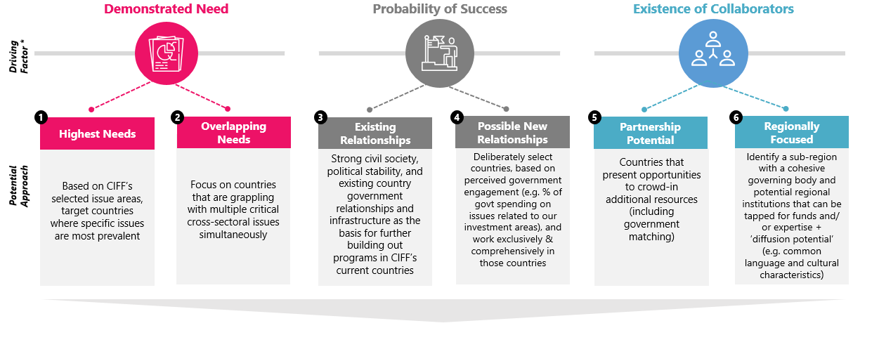
Geographic focus
Nigeria
Kenya
Ethiopia
Francophone West Africa Country

Slide 14
For Africa by Africa: Harnessing the power of African giving and African-led institutions in championing the African development agenda
IMPACT
SUSTAINABLE SOLUTIONS THAT IMPROVE THE LIVES OF CHILDREN AND ADOLESCENTS​
Increased African giving & government funding for development; ​
More African-led institutions championing the African investment agenda; ​
Increased ownership of the development agenda by African communities, governments & institutions ​
LONG-TERM OUTCOMES
Transparent platform for diaspora investment and community ownership in development​
Enhanced capacity of civil society in holding government accountable and sustaining momentum around CIFF’s priorities
Strong relations with governments, active support and co-investment within CIFF’s priority areas​
Partnerships and co-design of development solutions with African institutions (incl. government agencies, CSOs, and private sector)​
MEDIUM-TERM OUTCOMES

Slide 15
Thank You
@ciffchild
@ciffchild
@ciffglobal
www.ciff.org

